Slide 1



Using Online Learning to Prepare Adults for the Workplace
Robin Morgan
Professional Development and Online Course Designer
Rmorgan@ProLiteracy.org
Notes:
Welcome!
Introduction

Slide 2
What We’ll Talk About
The project
The 4 student courses:
  What’s included in each course
  The new ‘look’ and ‘feel’
  Slide examples
The instructor course
Exciting NEW FEATURES!
Accessing the Workforce Development Collection
Q & A
Notes:
Let’s get started by taking a quick look at what we’ll be talking about today.
First, we’ll talk about the project—what it is and why it is important. We won’t spend a lot of time here, but I think it will be helpful for you to know what went into deciding what to include in each of the courses.
We’ll spend most of our time looking at the student courses where you’ll learn what’s included in each course, you’ll become familiar with the new ‘look’ and ‘feel’, and you’ll see some slide examples. The student courses include:
Setting Employment Goals
Tailoring Your Resume
Acing the Interview, and
Communicating at Work.
We’ll also take a quick look at the instructor course-what it looks like, and what’s included.
I’ll highlight the recent updates and exciting new features (swipe, fully responsive-easy to view-scale to fit any device).
And, I’ll show you:
How to access the new Workforce Development Collection in Education Network
Where to set up a free account if you are a new Education Network, or EdNet user, and
How to set up free accounts for students so they can log in and work independently.
We’ve also built in some time at the end so you can ask questions. Let’s get started!

Slide 3
The Need
Now more than ever it’s important for students to have the skills they need to compete in a rapidly changing workplace.
Many students don’t have the skills they need to get and keep jobs. They:
  Lack the skills needed to get a job
  Have a job, but don’t know how to transition from a job to a career
  Lack the interpersonal and communication skills needed to keep a job
45% of students in Proliteracy’s member network are unemployed
Many English Language Learners are unprepared to enter the workforce and acclimate to workplace culture
Notes:
The need.
Now more than ever it’s important for students to have the skills they need to compete in a rapidly changing workplace.
The students we serve often fall into three groups:
Students who lack the skills they need to get a job
Students who have a job, but don’t know how to transition from a job to a career, and
Students who have difficulty keeping jobs because they lack the interpersonal and communication skills they need to be successful.
45% of students in ProLiteracy’s member network are unemployed.
In addition, 95% of ProLiteracy member programs provide English language instruction, and nearly 65% serve refugees. Many of these students are not prepared to enter the American workforce and successfully acclimate to workplace culture.

Slide 4

The Solution
Establish a national learning community
Survey local and national audiences
  Adult learners
  Service providers
  Local employers
Develop a series of free online courses
  Four direct-to-student courses
  One instructor course
Notes:
The Solution.
ProLiteracy received support from the Pitney Bowes Foundation to establish a national learning community and develop a series of direct-to-student online courses that would build capacity among community-based literacy and workforce development programs whose goal it is to prepare adults for the workplace.
To get started, we selected a group of direct service providers and field experts-the national learning community-to provide outside input and support (our ‘boots-on-the-ground.’).
Learning community members surveyed 285 students in their programs. They surveyed employers in their community, their staff, and their volunteers.
In addition, ProLiteracy sent a service provider survey out to our network of member programs. The survey results told us:
What students felt they needed the most help with, and
What was most important to students, instructors, and employers.
We asked questions about time constraints, computer access, free printing services, and the types of activities that would be the most useful. All of the information collected was used to help us determine how the courses should be structured and what types of activities to include.
The result was a series of four online direct-to-student courses, and one supplemental instructor course.

Slide 5
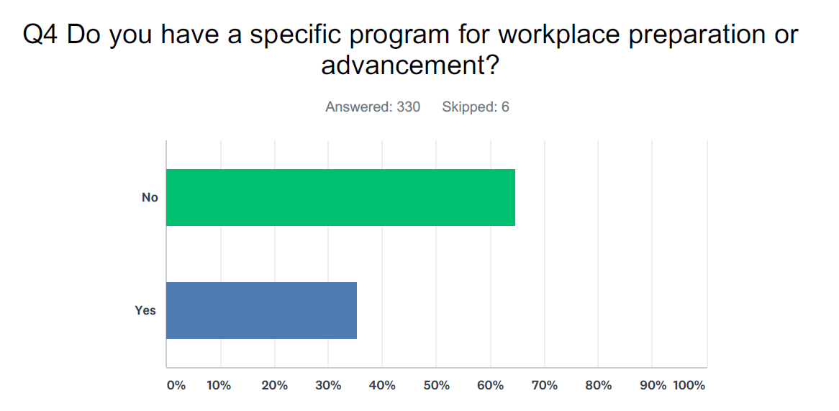
And the Survey Says…
From the providers survey:
About 65% of service providers are without a specific program in place for workforce development or advancement
Nearly 85% of providers said that an online workforce preparation course would be useful
Does your program have a specific program in place for workforce preparation or advancement?
What does it look like?
Notes:
This is one example of a question from the providers survey. It indicates that ~65%, or about 2 out of 3 service providers are without a specific program in place for workplace preparation or advancement.
And, an overwhelming majority of service providers surveyed, almost 85%, responded that an online workforce preparation course would be useful.
(Can I just get a show of hands in the room for how many of your programs have a specific program for workforce prep or advancement? [consider asking some people to quickly describe what that program looks like, or why they do not have a program].)

Slide 6
The Skills That Mattered Most
Service Providers
Command of Workplace English: 73.4%
Basic Computer Skills: 71.47%
Degree or Credential: 21.79%
Soft Skills: 71.47%
Critical Thinking: 52.56%
Time Management: 66.03%
Employers
Command of Workplace English: 76.09%
Basic Computer Skills: 80.43%
Degree or Credential: 28.26%
Soft Skills 63.04%
Critical Thinking: 76.09%
Time Management: 80.43%
Notes:
Here are some additional survey results.
When surveyed, both service providers and employers ranked effective workplace communication, basic computer skills, and soft skills as being of high importance.
Overall the results are in sync-but notice the additional emphasis employers placed on critical thinking and time management skills. This is reflected in the student courses.

Slide 7
The Courses
Student courses:
  Simple navigation
  Require minimal computer skills
  Edited by a plain language expert. Written at ~ the 4th grade level
  Completion time will vary, depending on student skill levels
Instructor course:
  All the features you are used to (and MORE!)
  Not a how-to. Focuses on areas of greatest difficulty, suggests additional activities
  Five modules
Notes:
So, we asked A LOT of questions and in total had 669 respondents (made up of students, service providers, and employers) who helped us make informed decisions on what should be included in our online courses. Their input also led us to give the student courses a new look—with simple navigation and less distractions.
The four student courses require minimal computer skills. They were edited by a plain language expert, to make sure the language was as simple as possible. They all read at, or around the 4th grade level. The amount of program or tutor support needed to successfully complete each course, and the time it will take, will vary depending on the skill level of each student.
The instructor course format is going look familiar. It contains all of the same features you have become accustomed to. The instructor course is not meant to be a ‘how to’ for teaching the courses. Rather, it focuses on the areas with which we think students will have the greatest difficulty, and offers ideas for additional activities.
The instructor course is made up of five modules. An introduction module, and one module pertaining to each of the four student courses.

Slide 8

Setting Career Goals
Students learn to:
Distinguish between a job and a career
Complete a career self-assessment
Research careers
Identify important factors when choosing a career
Differentiate between short- and long-term goals
Practice writing SMART career goals
Create a career plan
Notes:
Let’s take a quick look at what is covered in each of the student courses.
In Setting Career Goals, our focus was on helping students to reach beyond the jobs they, their friends, and family members have settled for in the past because they lacked the skills, knowledge, or confidence to do something different.
In the course Setting Career Goals, students learn to:
Distinguish between a job and a career
Complete a career self-assessment
Research careers
Identify important factors when choosing a career
Differentiate between short- and long-term goals
Practice writing their own SMART career goals, and
Create a career plan.

Slide 9

Tailoring Your Resume
Students learn to:
Customize their resume for specific job postings
Write about their skills and accomplishments
Use keywords to make their resume more likely to be accepted
Write a professional summary
Identify core qualifications
Describe their work and education
Write a cover letter
Use a resume template
Notes:
The emphasis in the Tailoring Your Resume course is on helping students to move from one-size-fits-all, generic resumes, to resumes that address the employer-specific needs for a particular job. We show students how to stand out in a crowd so they will be invited for an interview.
In the course Tailoring Your Resume, students learn to:
Customize their resume for specific job postings
Write about their skills and accomplishments
Use keywords to make their resume more likely to be accepted (including by scanning software)
Write a professional summary
Identify their core qualifications for a job
Describe their work and education
Write a cover letter, and
Use a resume template.

Slide 10

Acing the Interview
Students will:
Research companies where they want to apply for jobs
Prepare for interviews and job fairs
Practice responses to common interview questions
Practice responses to difficult questions
Learn how to make a good first impression
Learn how to follow-up after a job interview
Notes:
Acing the Interview. The focus for this course is practice-practice-practice. Students think ahead about the kinds of questions they might be asked, to tailor their answers based on job postings and what they know of the company, and to demonstrate to employers that they have taken the time to prepare.
In the 3rd course, Acing the Interview, students will:
Research companies where they want to apply for jobs
Prepare for in-person, phone, and Skype interviews, as well as job fairs
Practice responses to common interview questions
Practice responses to difficult questions about topics such as a criminal record, gaps in employment, and pay
Learn how to make a good first impression, and
Learn how to follow-up after a job interview, even if they have been turned down.

Slide 11

Communicating at Work
Students learn:
The importance of communicating effectively
How to identify communication roadblocks
How to use active listening strategies
To practice handling constructive feedback
To communicate as part of a team
Tips for phone, voicemail, and email messages
What nonverbal communication is and why it matters
Notes:
Learning Community Members told us they often hear from students about problems they have on the job-and sometimes cause them to be let go. They asked for a course that would go beyond helping students to get a job-and help them to develop the skills they need to keep the job.
In the final student course, Communicating at Work, students learn:
The importance of communicating effectively in both speech and in writing
How to identify communication roadblocks, and
How to use active listening strategies.
Students also learn:
How to practice handling constructive feedback
How to communicate as part of a team
Tips for talking on the phone, leaving voicemail, and writing professional emails, and
What nonverbal communication is and why it matters

Slide 12
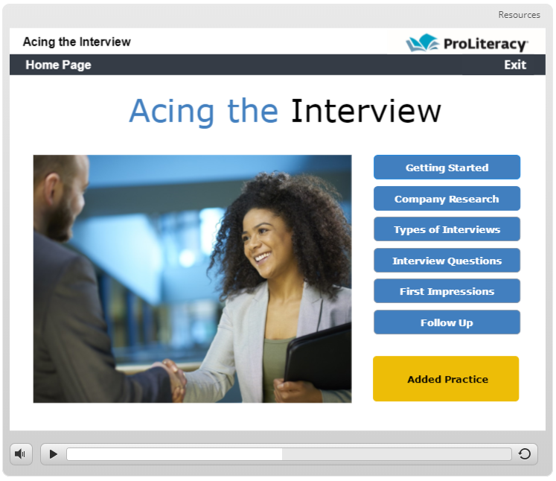
The Home Page
Notes:
Now that you know what’s included in the courses, we’ll look at some of what has changed, beginning with the addition of a Home Page.
Each of the buttons you see here takes students to a different lesson, and when they finish a lesson they are prompted to click to return to the homepage where they can begin the next lesson.
Every course begins with the same Getting Started lesson—the top button—where students learn how to move around. This is the same in each student course.
The first time through, we recommend taking the lessons in the order they are presented here, but it is not required. Tutors and students can click any button to begin, or to revisit a topic.
Three of the four courses have an Added Practice section, as identified by the larger, different color button at the bottom of the screen. Students can move through the lessons fairly quickly, but the Added Practice section takes time. Completing the Added Practice section is optional—but most students will benefit from the activities.

Slide 13
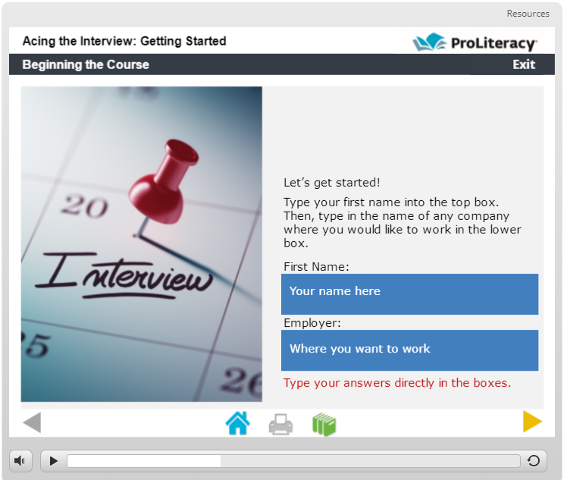
The Navigation Bar
Notes:
Once inside, you’ll notice the student courses are aesthetically different. That’s because we eliminated the additional text and menu bar to make navigation more intuitive.
This is an example from the Getting Started lesson that appears at the beginning of each course. It allows students to add information to personalize the course a bit.
[In response to users and national learning community members , we have added some additional features, such as a progress bar (it will show up as a button on iPads and smaller devices) to indicate slide progress. Other changes include:
Shorter, simpler slides
Easier viewing on small devices, and
A separate transition slide at the end of each lesson.
We are also working on making the student courses available offline. This new feature will be rolled out just in time for the ProLiteracy conference, if not before.]

Slide 14
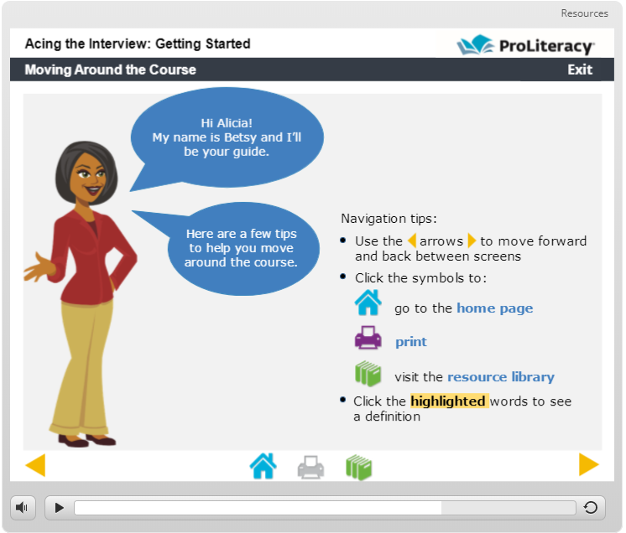
Moving Around the Course
Notes:
This slide demonstrates how students move around the courses.
Each of the student courses are narrated by Betsy, the guide. She’s new.
Students use the forward and back arrows to move between slides. They can click the house button on the bottom task bar to return to the Home Page. When the icons are in color they are active. For example, the print icon is grayed out rather than being purple, so there is not a print option from this screen. Clicking the green books gives students one click access to all of the handouts—not just what is on the current slide.
Key words that students may not know, but are important are highlighted in yellow. Students click on the highlighted words and a pop-up definition box appears. Each definition is also included on a definition handout.
Look at the top speech bubble. It includes one example of course personalization.

Slide 15
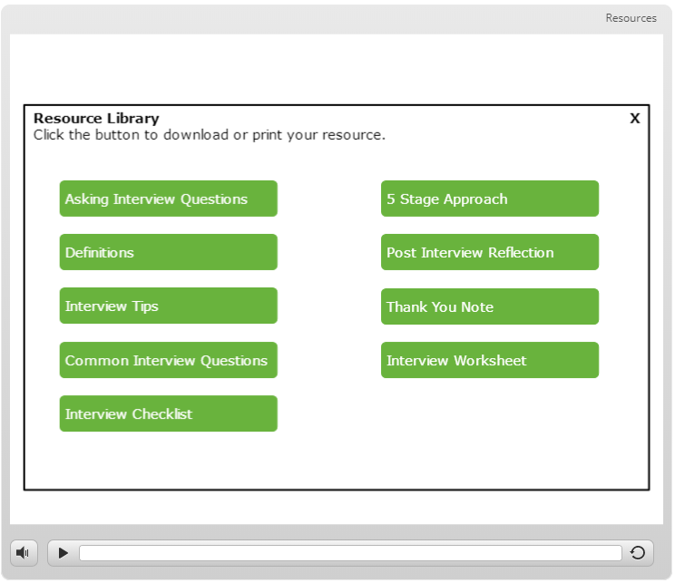
The Resource Library
Notes:
In the last slide you learned that when students click on the green books, they are directed to a resource library. This is what it looks like. Students can download and read any resource, any time. NEW: They can also access all resources, including links to outside sources and videos, by clicking RESOURCES at the top right of the screen. The resources will appear in a drop-down menu. On a smaller device, the resource section looks differently-it’s three bars ( a hamburger menu).
The green books symbol on the taskbar is active for EVERY slide-and it includes EVERY handout, making it easy for students to go back and find the resource they need without searching through the individual screens.
It’s important to note that the individual lessons are not printer dependent. For example, if a student is working in the Types of Interviews lesson, they can complete the entire lesson without the benefit of having access to a printer. They may be directed to a handout, but they can download and read the handout and print later without sacrificing the effectiveness of the lesson. This matters because in the upcoming version the slides will scale to fit any size screen—and will even be accessible offline—making it even easier for students to learn on the go.
It isn’t until students begin the Added Practice section that printing a specific worksheet becomes important. The worksheet includes work space for all of the activities, and in many cases, serves as a template for new job searches.

Slide 16
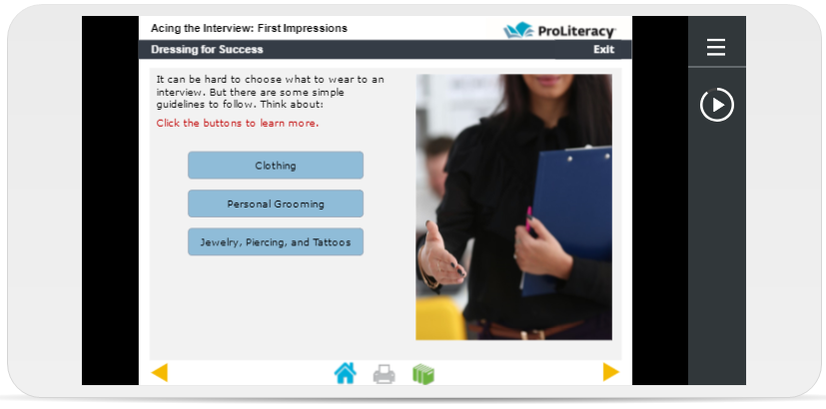
Mobile Devices
Notes:
Here is an example of what it looks like to view a slide on a mobile device, in this case, an iPhone 6.
Clicking the hamburger menu (the three bars) on the top right reveals a drop down resource list. Or, students can go to the resource library by clicking the green book symbol on the navigation bar at the bottom of their screen.
The progress bar is circular. It’s located right under the resource menu. Students can pause and play from here-but they cannot manipulate the button in the same way they can the full progress bar when viewing on a full size device (desktop or laptop computer).
The forward and back arrows have oversized invisible covers that make it easier to use the buttons on very small screens. Students using touch screen devices have the option to swipe forward and back to move between screens.

Slide 17
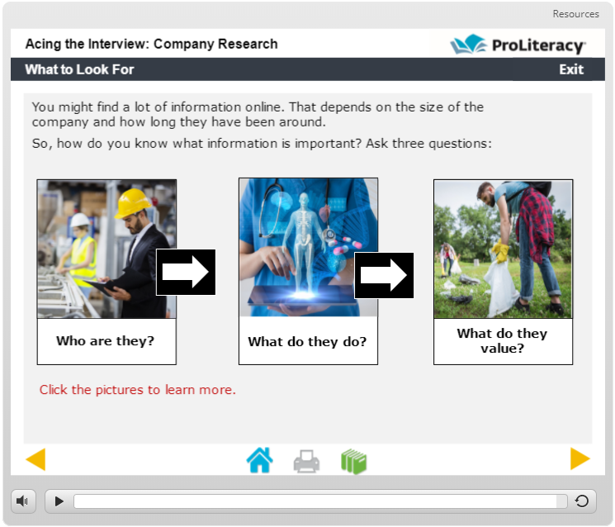
Slide Interactivity
Notes:
Here’s an example of the kind of interactivity students might see when they are taking a course, including:
Clickable images and buttons
Audio and video examples
Pop-up layers with additional information, and
The pop-up definitions I mentioned earlier.
In the slide you see here, students click on the images to learn more about what to look for when researching a company they may want to work for. The pop-up boxes minimize the amount of text appearing on the screen at one time, making it easier for learners to follow along and remember what they learned.
New: Many of the slides in the original courses have been reworked to be shorter-they have been broken up into separate slides. The content itself has not changed, just the way it is presented.

Slide 18
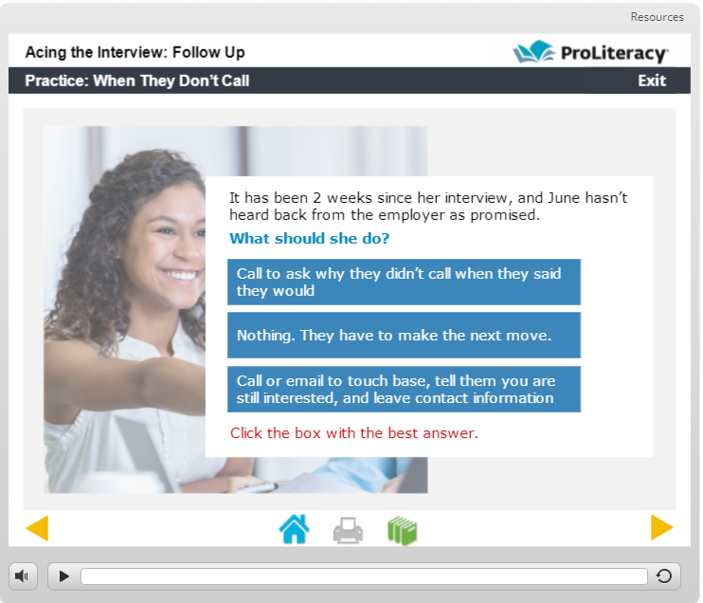
Knowledge Checks
Notes:
Every lesson includes knowledge checks. The knowledge checks are primarily scenario-based like what you see here.
In all cases, students can answer as many times as they need, and feedback is provided for all answers. Incorrect answers prompt students to ‘Try Again.’ Correct answers prompt students to ‘Continue.’
The questions aren’t meant to be difficult—they are meant to test the student’s understanding, and allow them to experience success.

Slide 19
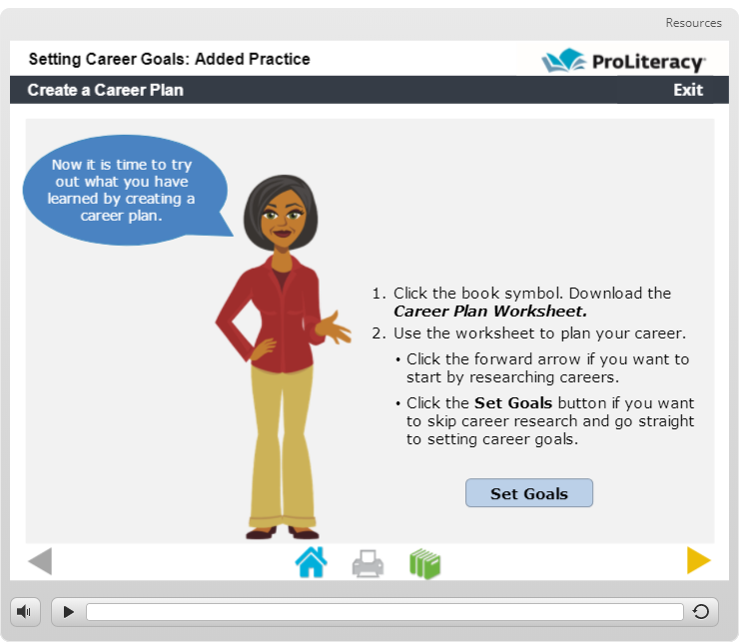
The Added Practice
Notes:
The Added Practice section is where students apply what they have learned about setting goals, creating a resume, or acing an interview, to their own lives and employment needs. The activities reinforce what they have learned, while giving them the option to prepare for their own job search or interview.
Look at the example on the screen. In the Setting Career Goals course, students can start in 1 of 2 places-either researching careers or going straight to setting goals.

Slide 20
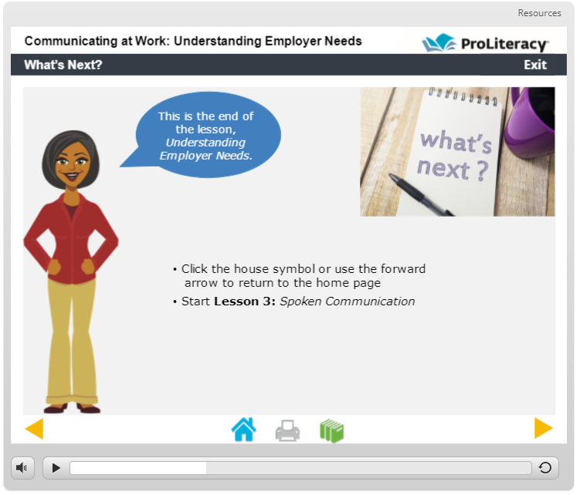
A Transition Slide
Notes:
To make navigation easier, a transition slide has also been added to the end of each lesson in the student courses.

Slide 21

Instructor Course
Five modules:
  Introduction
  Setting Employment Goals
  Tailoring Your Resume
  Acing the Interview
  Communicating at Work
Resources include:
  18 handouts
  15 audio and video examples
  Discussion Board
  Links to outside resources
Notes:
As mentioned earlier, the instructor course, Preparing Adults for the Workplace, is a supplemental course for teachers using the four direct-to-student courses with their students. It contains:
An introduction module, and
A module on each topic, with teaching ideas and additional activities for each.
The course is loaded with resources, including:
18 handouts
15 audio and video examples
A discussion board, and
Multiple links to outside resources.

Slide 22
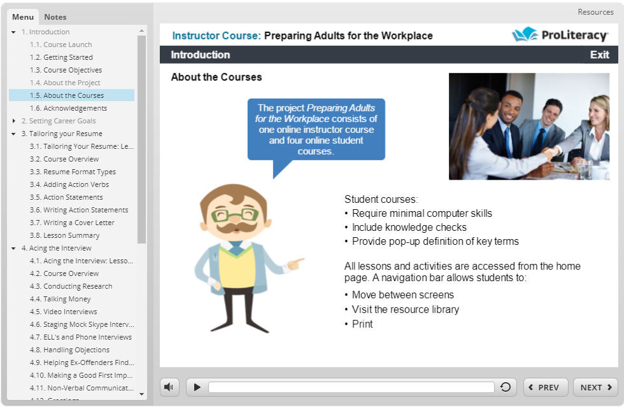
Menu & Notes
Notes:
The instructor course includes:
A slide menu from which you can see your progress and select the slides you want to visit
A progress bar at the bottom that lets you know when the slide audio is done, and allows you to replay the slide, and
Single click navigation that allows you to adjust the volume, and move forward and back between slides.
You can exit the course at any time by clicking Exit in the upper right corner. The system will save the location, and when you sign back in you can begin where you left off, over go back to the beginning.
Links to handouts and resources are included on the individual slides. New: A resource section has been added-similar to what is in the student courses.
Also, if you look at the top left you’ll see a ‘Notes’ tab, right next to ‘Menu.’ Clicking the notes tab allows you to read the slides notes—the text version of the audio. A screen reader can also be used with both the instructor and student courses.

Slide 23
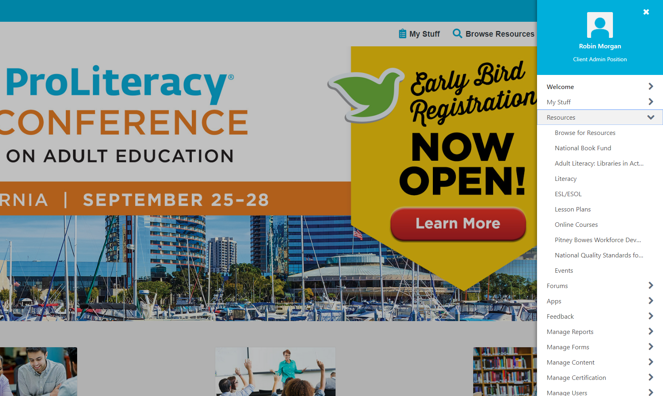
www.proliteracy.org
Notes:
To access these free courses, you must have a ProLiteracy Education Network account (EdNet for short).
If you already have an EdNet account (not to be confused with a ProLiteracy membership), you can browse EdNet resources as you have always done.
Just log in and:
Click on the hamburger menu (the three bars) on the top right corner of the page
Click on menu, and
Select Resources, then, Pitney Bowes Workforce Development Collection.
These courses, as well as other workforce development resources, are all in one easy to find location.

Slide 24
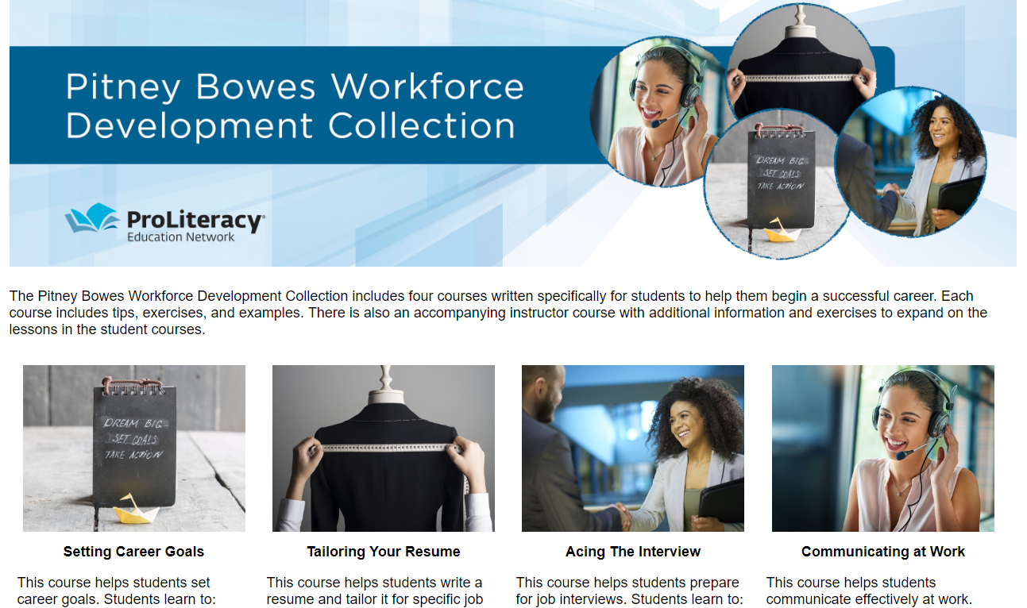
proliteracyednet.org/workforce
Notes:
If you don’t already have an EdNet account, you can use the shortcut provided here. Just type proliteracyednet.org/workforce into your browser. Then use one of the buttons at the bottom of the page to create an account.
Let’s take a look.

Slide 25
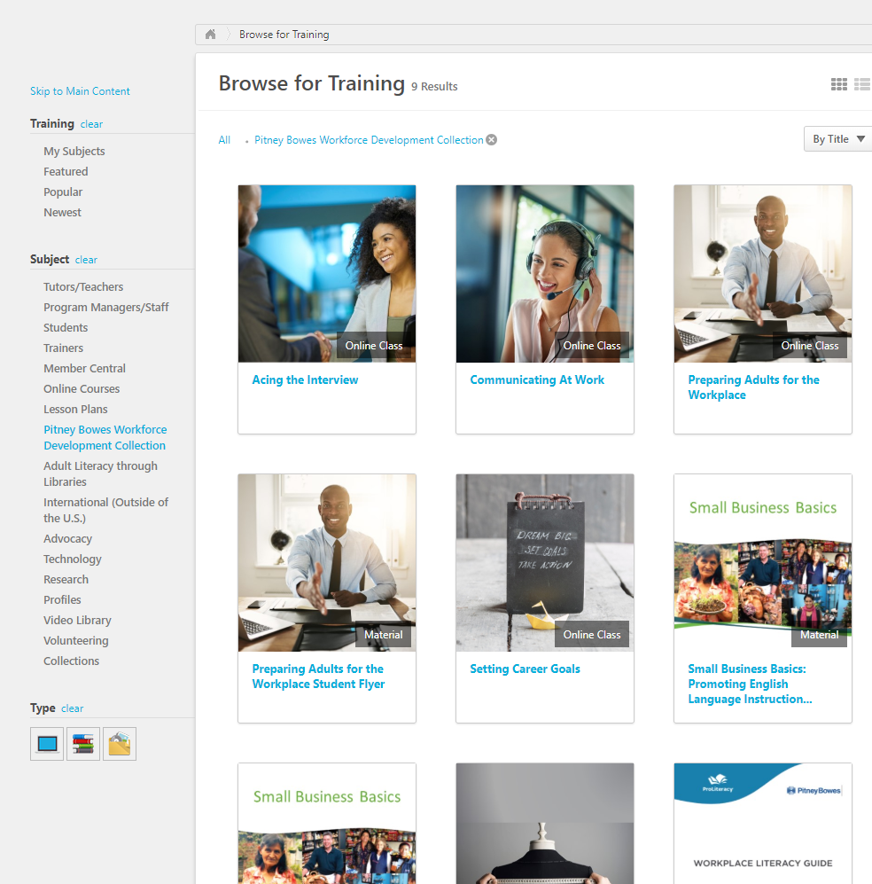
Setting Up a Student Account
Follow these steps:
Go to proliteracyednet.org/workforce
Click the green Create Account button
Check the I’m not a robot box, click Next
Type your new password into the boxes
Choose and answer the Security Question, click Continue
Select Resources from the drop down list
Click on Pitney Bowes Workforce Development
Notes:
Students need to have a free account too.
I’ve listed the steps here, but you can go to the Pitney Bowes Resource Collection to download the Preparing Adults for the Workplace Student Flyer. To make things easier, I’ve also printed a copy for each of you.
Page 2 of the flyer lists step-by-step instructions for setting up a student account, and logging in the next time. It even includes a place for students to write down their password.
You can use the flyer in its entirety—both pages—to promote the courses with tutors and students.

Slide 26
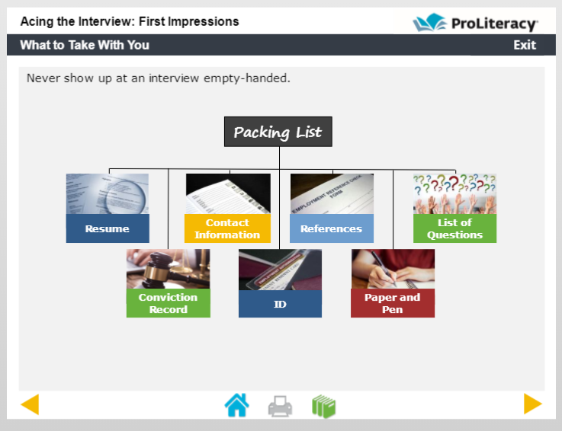
Additional Resources
WorkWise:
Choosing a Job
Getting a Job
Starting a Job
Reading at Work
Writing at Work
Math at Work
www.newreaderspress.com/workwise
Notes:
The topics where you will spend the most time will vary depending on the skills and experience of the students you are working with. We’ve included highlights and basic activities to get you started, but you can use the WorkWise series from New Readers Press to supplement learning and make lesson planning easier.
You can find these, and other workforce related resources at www.newreaderspress.com.

Slide 27


Any Questions?

Slide 28
Thank you for attending:
Using Online Learning to Prepare Adults for the Workplace
If you have questions or would like more information on this subject, please contact me at:
RMorgan@ProLiteracy.org

