Slide 1
Thick Descriptions
Literacy Healing
Science Empowerment/Cultural Intelligence

Slide 2
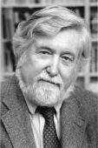
We are an Oklahoma-based organization. The term is everything and everyone is thick-in-description. This term is coined by Clifford Geertz, a famous anthropologist.
What is Thick Descriptions?
Who is Clifford Geertz?
Why is anthropology needed?
It helps us understand each other through natural and social sciences.
Science Empowerment/Cultural Intelligence

Slide 3
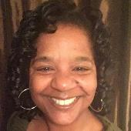
About Me
Native Californian
Moved to Oklahoma - 2002
Obtained two Masters from the University of Oklahoma.
Library and Information Studies
Anthropology
Wife and Mother of Two
Bonus Mom of Four
Director of the Guthrie Public Library

Slide 4
Why is Literacy Healing Important?
1) According to the U.S. Census Bureau, as of 2015, the state of Oklahoma has an estimated population of 3,911,338, which is an increase of 159,987 or 4.26% since the year 2010. Oklahoma is the 28th most populous state in the United States.
2) Most scientists contend that our population will continue to increase due to cost of living.
3) New Oklahomans bring their beliefs/perspectives and understandings.
4) “This is how we’ve always done it.”
Science Empowerment/Cultural Intelligence

Slide 5
1) According to the National
Assessment of Adult Literacy defined literacy as:
“Using printed and written information to function in society, to achieve one’s goals, and to develop one’s knowledge and potential.”
2) The study found that 30 million adults or 14% of the adult population functioned at the Below Basic level due to poor reading, writing, comprehension and math skills
3) An additional 63 million or 29% of adults had only Basic literacy skills.
4) In Oklahoma, 342,045 (12%) of adults over the age of 18 function at the Below Basic literacy level, and 883,618 (31%) adults were at the Basic literacy level.
Science Empowerment/Cultural Intelligence

Slide 6
What is Literacy Healing?
Science Empowerment/Cultural Intelligence

Slide 7
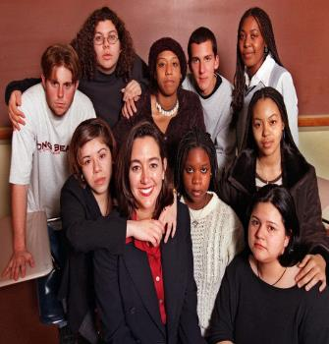
Freedom Writers - 2007
Science Empowerment/Cultural Intelligence

Slide 8
CONTEXT
And
PROACTIVE
Culturally Intelligent
Science Empowerment/Cultural Intelligence

Slide 9
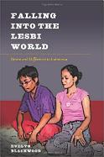
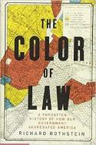
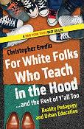
How to Execute Literacy Thinking?
1) Be willing to ask questions. Start within “your normal” and gradually step outside your comfort zone.
2) Read as much as you can about power dynamics/social constructs/how people learn.
Science Empowerment/Cultural Intelligence

Slide 10
How to Execute Literacy Thinking?
3) Know there will be discomfort but continue to try.
4) Take the bias test.
Science Empowerment/Cultural Intelligence

Slide 11
Follow Us
Facebook/Instagram/Twitter
Science Empowerment/Cultural Intelligence

