Slide 1
“I’m Not Afraid of Math Anymore!”
Interactive Foldables and
Math Videos

Slide 2
Susan E. Bernard
Author and Publisher
Adult Ed Teacher – 17 years
High School Equivalency Coordinator Oklahoma City Community College Adult Learning Center

Slide 3
Why use Foldables and Videos?
For Teachers:
To learn about high school equivalency math concepts
To introduce a topic in class

Slide 4
Why use Foldables and Videos?
For Students:
To get a “heads-up” for the next lesson
To make up a missed lesson
To review with any smartphone, tablet, or computer

Slide 5
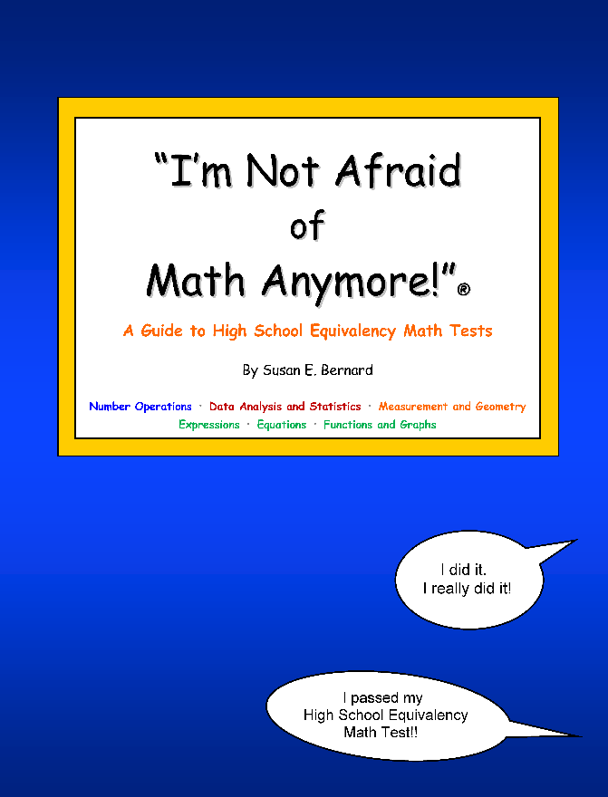
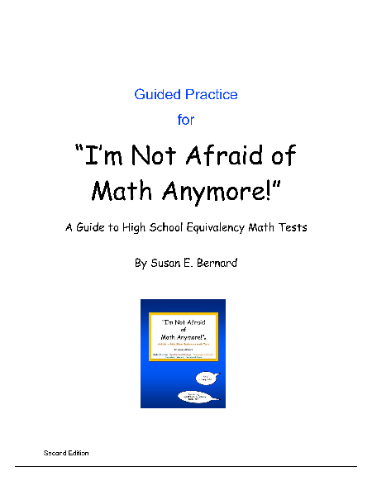
“I’m Not Afraid of Math Anymore!”
Foldables and videos are based on the “I’m Not Afraid of Math Anymore!” GED®-HSE preparation books.
www.imnotafraidpublications.com

Slide 6
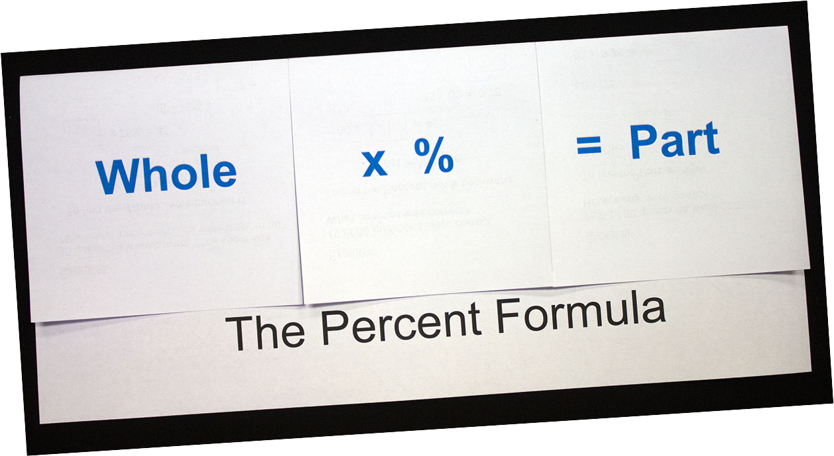
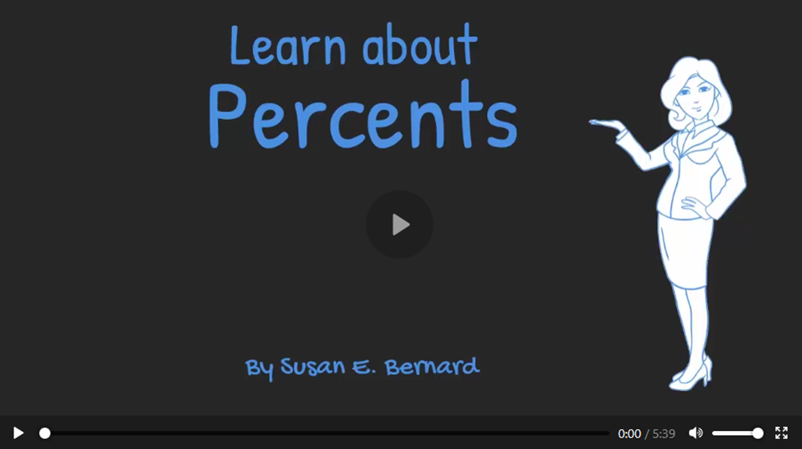
“I’m Not Afraid of Math Anymore!”
www.imnotafraidpublications.com/videos.html

Slide 7
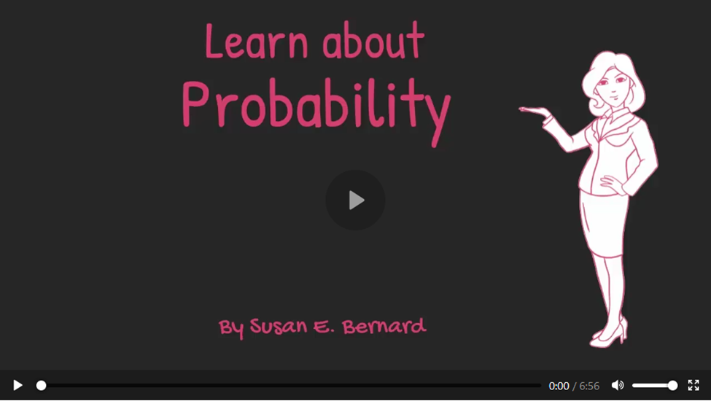
“I’m Not Afraid of Math Anymore!”
www.imnotafraidpublications.com/videos.html

Slide 8
“I’m Not Afraid of Math Anymore!”
www.imnotafraidpublications.com/videos.html

Slide 9
“I’m Not Afraid of Math Anymore!”
www.imnotafraidpublications.com/videos.html

Slide 10
“I’m Not Afraid of Math Anymore!”
www.imnotafraidpublications.com/videos.html

Slide 11
“I’m Not Afraid of Math Anymore!”
Foldables and videos are based on the “I’m Not Afraid of Math Anymore!” GED®-HSE preparation books.
www.imnotafraidpublications.com

