Slide 1
Applying for accommodations for the High School Equivalency tests
WELCOME
Pamela K. Watts, M.Ed. in Learning Disabilities; B.S. in Special Education
Oklahoma City Community College
Adult Education and Literacy Instructor
pamela.k.watts@occc.edu

Slide 2
Overview of the Presentation
Review of the current test vendors and access to accommodations from their website
5 step approach to applying for accommodations
Interview with student and/or parent or guardian – questions to ask
Documentation guidelines for each eligible disability
Completing the request forms for each eligible disability
Interpreting the accommodations decision from the testing service
Recourse and supporting learners if the accommodation is not approved
Americans with Disabilities Act (ADA) and ADA Amendments Act (ADAAA)

Slide 3
Educational Testing Service® ets.org
https://hiset.ets.org/requirements/disabilities/
HiSET®

Slide 4
GED® Testing Service LLC (Pearson) ged.com
https://ged.com/about_test/accommodations/
GED®

Slide 5
Test Assessing Secondary Completion™ tasctest.com Data recognition Corporation
TASC™
https://tasctest.com/demo-home/test-takers/taking-tasc-test/accommodations-for-disabilities/

Slide 6
5 step approach to
Applying for Accommodations
Step 1: Interview with student, parent, and or guardian.
Step 2: Determine accommodations the student needs.
Step 3: Collect disability/disorder documentation.
Step 4: Fill out required forms.
Step 5: Submit request.

Slide 7
Step 1: Questions to ask in the interview
Tell me about your school history.
Were you ever on an IEP or 504 Plan?
If so, do you have a copy of it?
What accommodations did you have in school?
How did you learn best when you were in high school: small group, tutor, home school, slower paced lessons?
Explain the requirements of using an IEP or 504 Plan.
How do you learn best now when you are in the adult education classroom or studying at home?
How do you compensate for your disability?
Explain available accommodations.
What disabilities or disorders do you have?
Do you have current testing for your disability or disorder?
How do you compensate for your disability?
Do you use technology?
Are you on medication?
Explain documentation requirements for applying for accommodations.
When do you plan on taking the HSE test?
Will you take the CBT or the PBT?
What accommodations will you want to take the test?
Do you concentrate better when it is quiet and you have no distractions?

Slide 8
Accomodations not requiring a Request
Not every accommodation requires prior approval from ETS. Many test centers provide items to support your testing, or allow you to bring test support items.
On the day of your test, your test center will have the following items available to everyone:
Large print test book (14-point) and answer sheet
Scratch paper (to be collected by test center personnel at end of testing session)
Wheelchair access
Your test center may also be able to provide preferential seating so you can better hear instructions or cut down on distractions.

Slide 9
Items provided by test taker
If you need one of the following items, you must bring it with you.
Colored transparent overlays (for paper-delivered testing only).
Colored scratch paper (to be collected by test center personnel at end of testing session).
Earplugs (not attached to any electronic device).
Plain, unmarked straightedge to assist with keeping place while reading. You may use a piece of scrap paper for this purpose, but it must be returned at the end of the testing session.
Handheld nonelectric magnifying device (without memory or camera).
Seat cushion/back pillow, or footstool. Item will be inspected by test center personnel before and after testing.
Prescription medication. Must be in the prescription bottle with a label indicating your name, dosage and directions.
Service animals.
Medical devices (e.g., asthma inhaler, hearing aid, pacemaker, insulin pump on vibrate or silent, oxygen tank, TENS stimulator).
Highlighter or black felt pen for essays and scratch work only.

Slide 10
Tell me about your school history.
Were you ever on an IEP or 504 Plan?
If so, do you have a copy of it?
What accommodations did you have in school?
How did you learn best when you were in high school: small group, tutor, home school, slower paced lessons?
How do you learn best now when you are in the adult education classroom or studying at home?
Do you concentrate better when it is quiet and you have no distractions?
How do you compensate for your disability?
What disabilities or disorders do you have?
Do you have current testing for your disability or disorder?
How do you compensate for your disability?
Do you use technology?
Are you on medication?
When do you plan on taking the HSE test?
Will you take the CBT or the PBT?
What accommodations will you want to take the test?

Slide 11
Step 2 - Accommodations
Testing Accommodation | Paper (PBT) | Computer (CBT)
Extended time (25%: time and one-quarter, 50%: time and one-half, 100%: double time) | ✔ | ✔
Separate room | ✔ | ✔
Additional supervised break time | ✔ | ✔
Screen magnification/large moniter/Zoomtext |  | ✔
Large print (larger than 14 pt.)* /CCTV *Blind or Low Vision | ✔
Braille test* | ✔
Braille slate and stylus or Perkins brailler* (for note taking only) | ✔ | ✔
Refreshable Braille* | ✔ | ✔
Screen Reader ( i.e. JAWS)* |  | ✔
Recorded audio with or without tactile figure supplement or large-print supplement* | ✔ | ✔
Scribe or keyboard entry aide | ✔ | ✔
Reader | ✔ | ✔
Printed copy of spoken directions | ✔
Sign language or oral-interpreted instructions for test takers who are deaf or hard of hearing | ✔ | ✔
Special Lighting | ✔ | ✔
Adjustable chair/preferred seating | ✔ | ✔
Talking calculator/adaptive equipment | ✔ | ✔

Slide 12
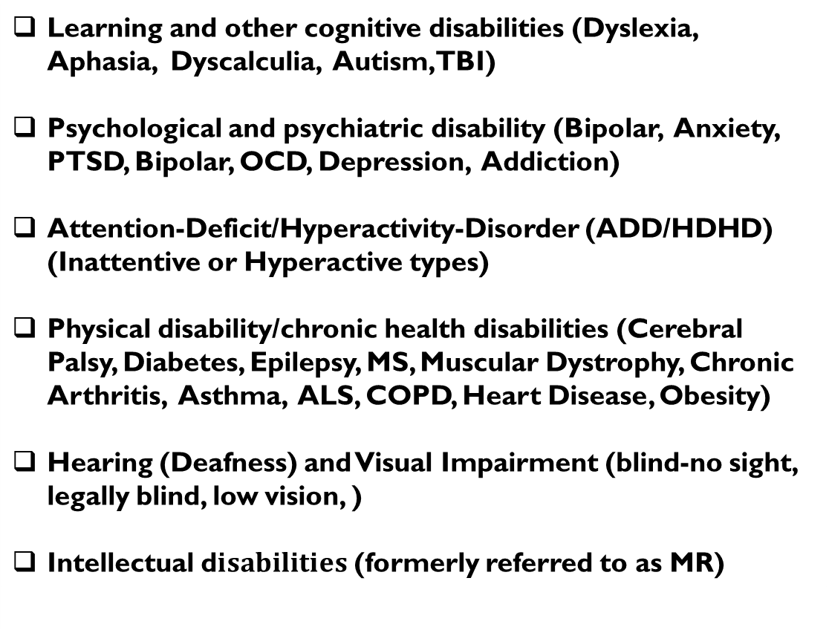
$$Timeline for Disability and Disorder Supporting Documentation.$$
Disability Categories
HiSet ® GED ® TASC ®
Learning and other cognitive disabilities (Dyslexia, Aphasia, Dyscalculia, Autism, TBI) Psychological and psychiatric disability (Bipolar, Anxiety, PTSD, Bipolar, OCD, Depression, Addiction) Attention-Deficit/Hyperactivity-Disorder (ADD/HDHD) (Inattentive or Hyperactive types) Physical disability/chronic health disabilities (Cerebral Palsy, Diabetes, Epilepsy, MS, Muscular Dystrophy, Chronic Arthritis, Asthma, ALS, COPD, Heart Disease, Obesity) Hearing (Deafness) and Visual Impairment (blind-no sight, legally blind, low vision, ) Intellectual d$isabilities$ (formerly referred to as MR)
w/in 5 yrs | < 5 yrs | Current
w/in 1 yr | < 1 year | Current
w/in 5 yrs | < 5 yrs | Current
w/in 1 yr | < 1 year | Current
w/in 2 yrs | < 1 year | Current
w/in 5 yrs | < 5 yrs | Current

Slide 13
Step 3 – Collect Supporting Documentation
ADD, ADHD, Autism Spectrum Disorder, Learning/Cognitive/Intellectual Disability : Documentation must be current within 5 years. Submit one: □ Psychological report □ Psycho-educational report □ Neuropsychological report or □ Other (i.e., IEP or 504 Plan)
Cognitive (IQ, achievement)
Emotional
Behavioral
Executive Functioning
Comprehensive achievement/cognitive test battery
Diagnosis based on DSM-IV/V criteria with evidence to support diagnosis
Educational background/Psycho-social history
Functional limitations discussed and rational for accommodations
Psychological tests plus: Attention, Concentration, Verbal and Visual Memory, Auditory and Visual Processing, Visual-Special Functioning, Phonology and Audiology, Sensory Integration, Gross and Fine Motor Development
Refer to info below:
A Psychological, Psycho-educational, or Neuropsychological report
must be from one of the following trained professionals:
Clinical psychologist
Educational psychologist
School Psychologist
Neuropsychologist
Learning Disability Specialist
Using an IEP or 504 Plan for documentation
An IEP or 504 Plan may be used in the following circumstances:
• Your disability is a learning disability, ADHD, intellectual disability, and/or autism spectrum disorder (including Asperger’s Syndrome); and
• You are requesting only 50% extended time and/or breaks; and
• The IEP or 504 Plan clearly states that you received extended time on tests; and
• The IEP or 504 Plan is no more than five years old. If you do not meet all of these requirements, complete documentation as outlined on Part III.
Reminders for Learning, Cognitive, or Intellectual Disability:
Has timed and untimed achievement test been administered to the learner (processing speed)
Do the test results match reported history and prior psycho-educational evaluations
If an IEP is being submitted does it include a psycho-educational assessment report
An abbreviated or mini IQ/achievement test battery do not meet the guidelines (WRAT-4 is not sufficient achievement testing without another test battery)

Slide 14
Step 3 – Collect Supporting Documentation
Blind or Low Vision:
Documentation must be current within 2 years. Submit both: □ Report from eye-care professional and □ Your personal statement
Deaf or Hard of Hearing: Documentation must be current within 2 years. Submit both: □ Audiogram or audiometric report and □ Your personal statement
Physical Disability or Health-related Need:
Documentation must be current within 1 year. Submit both: □ Letter from your physician and □ Your personal statement
Psychiatric or Psychological Disability: Documentation must be current within 1 year. Submit one: □ Psychological report or □ Letter from psychiatrist Psychological Report: Cognitive (IQ, achievement), Emotional, Behavioral, Executive Functioning evaluations.
Traumatic Brain Injury: Documentation must be current within 3 years. Submit only: □ Neuropsychological report
Is there congruence between what is requested and what the evaluator recommends? Is there a rationale for all requested accommodations? Is there a history of the disability/disorders provided in the report/documentation? Have the functional limitations of the individual/disability been discussed? Is the disability/diagnosis recognized under the ADA? (test anxiety, ESL, or substance abuse are not covered/recognized under the law.

Slide 15
Step 4 – Fill out the forms

Slide 16
Step 5 – Submit the forms

Slide 17
After the request…
Interpreting the accommodations decision from the testing service
Recourse and supporting learners if the accommodation is not approved
Americans with Disabilities Act (ADA) and ADA Amendments Act (ADAAA)

